Slide 1
TIME-SERIES PREDICTION OF SPRAY CHARACTERISTICS USING CLASSICAL MACHINE LEARNING APPROACHES (RESULTS)
By Yuvin Raja
(22BCE3942)

Slide 2
Link to repository
https://github.com/yuvinraja/spray-vision

Slide 3
Overall results of Baseline ML Models
model | Overall R2 Score | Overall MAE Score | Overall MSE Score
KNN | 0.9987 | 0.7405 | 2.1985
Gradient Boosting | 0.9948 | 0.4812 | 0.7828
Decision Tree | 0.9936 | 1.1068 | 4.1550
SVR | 0.9883 | 1.2921 | 17.127
Random Forest | 0.9829 | 2.2071 | 20.730
Linear Regression | 0.8340 | 4.7794 | 78.2915

Slide 4
model | target | r2 | mae | mse
LinearRegression | angle_mie | 0.656705 | 0.569254 | 0.535734
LinearRegression | length_mie | 0.938614 | 9.39516 | 167.0818
LinearRegression | angle_shadow | 0.790514 | 0.424916 | 0.298768
LinearRegression | length_shadow | 0.950467 | 8.728603 | 145.2497
DecisionTree | angle_mie | 0.987761 | 0.044399 | 0.0191
DecisionTree | length_mie | 0.996518 | 2.280267 | 9.478453
DecisionTree | angle_shadow | 0.992672 | 0.059458 | 0.010451
DecisionTree | length_shadow | 0.997575 | 2.043103 | 7.112309
RandomForest | angle_mie | 0.982864 | 0.104176 | 0.026742
RandomForest | length_mie | 0.985769 | 4.251561 | 38.73477
RandomForest | angle_shadow | 0.978371 | 0.121515 | 0.030847
RandomForest | length_shadow | 0.984952 | 4.351215 | 44.12774
SVR | angle_mie | 0.99487 | 0.069746 | 0.008005
SVR | length_mie | 0.987971 | 2.432815 | 32.74171
SVR | angle_shadow | 0.982614 | 0.110088 | 0.024796
SVR | length_shadow | 0.987813 | 2.555885 | 35.73678
KNN | angle_mie | 0.999426 | 0.018704 | 0.000895
KNN | length_mie | 0.998422 | 1.423397 | 4.295415
KNN | angle_shadow | 0.998858 | 0.02779 | 0.001629
KNN | length_shadow | 0.998467 | 1.49246 | 4.496412
GradientBoosting | angle_mie | 0.98727 | 0.056967 | 0.019865
GradientBoosting | length_mie | 0.99942 | 0.908359 | 1.579072
GradientBoosting | angle_shadow | 0.993257 | 0.068814 | 0.009617
GradientBoosting | length_shadow | 0.999481 | 0.890721 | 1.522695

Slide 5
Comparison between ANN and KNN
Model | Target | R2 | MAE | MSE
Kth Nearest Neighbour Regressor | Angle (Mie) | 0.9994 | 0.0187 | 0.0008
 | Length (Mie) | 0.9984 | 1.423 | 4.2954
 | Angle (Shadow) | 0.9988 | 0.0277 | 0.0016
 | Length (Shadow | 0.9984 | 1.4924 | 4.4964
Artificial Neural Network (ANN) | Angle (Mie) | 0.9910 | 0.0954 | 0.0140
 | Length (Mie) | 0.9924 | 3.3012 | 20.5885
 | Angle (Shadow) | 0.9849 | 0.1192 | 0.0216
 | Length (Shadow | 0.9932 | 3.1945 | 20.0414

Slide 6
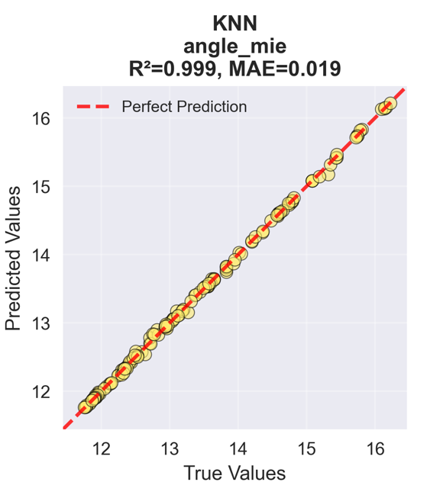
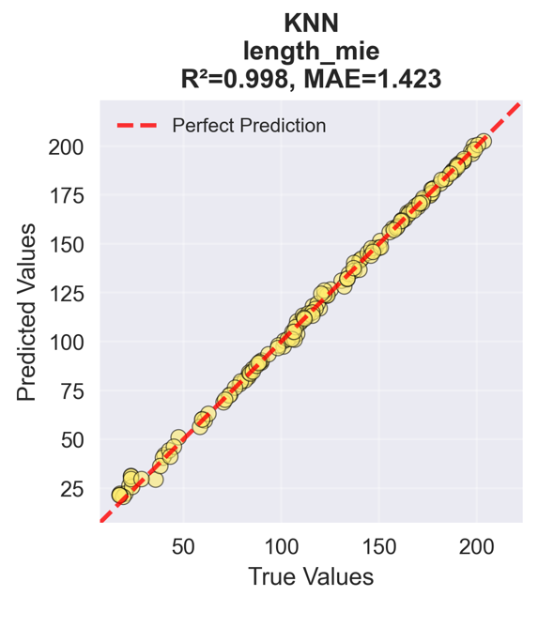
True vs Predicted for KNN

Slide 7
Comparison between ANN and Gradient Boosting
Model | Target | R2 | MAE | MSE
Gradient Boosting Regressor | Angle (Mie) | 0.98727 | 0.056967 | 0.019865
 | Length (Mie) | 0.99942 | 0.908359 | 1.579072
 | Angle (Shadow) | 0.993257 | 0.068814 | 0.009617
 | Length (Shadow | 0.999481 | 0.890721 | 1.522695
Artificial Neural Network (ANN) | Angle (Mie) | 0.9910 | 0.0954 | 0.0140
 | Length (Mie) | 0.9924 | 3.3012 | 20.5885
 | Angle (Shadow) | 0.9849 | 0.1192 | 0.0216
 | Length (Shadow | 0.9932 | 3.1945 | 20.0414

Slide 8
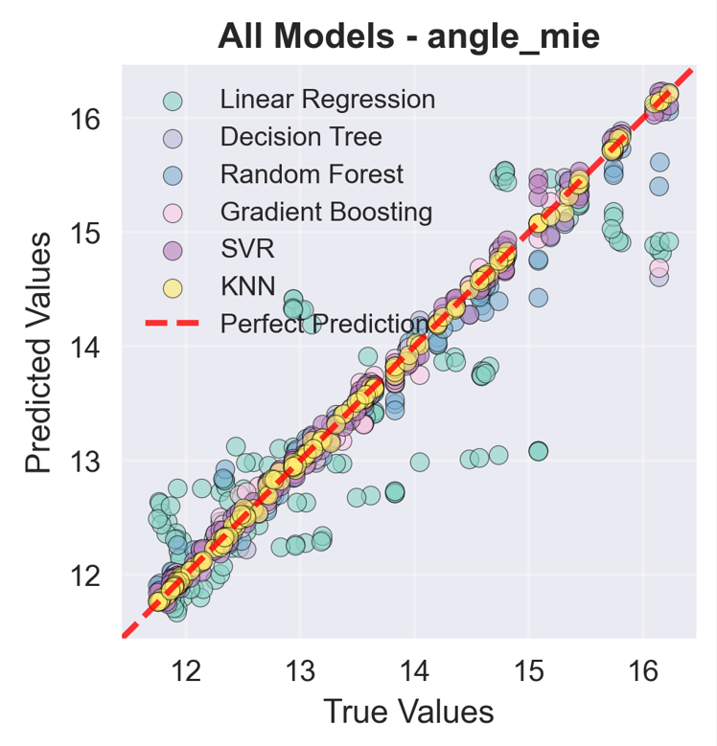
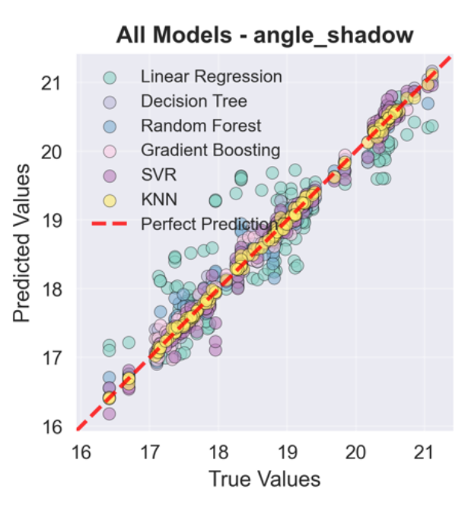
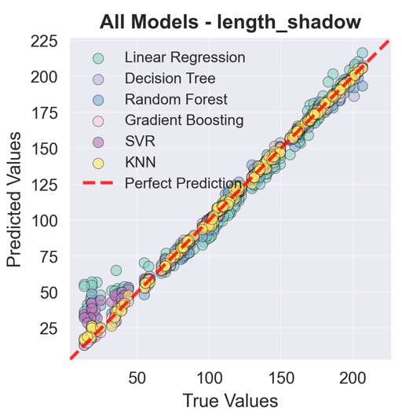
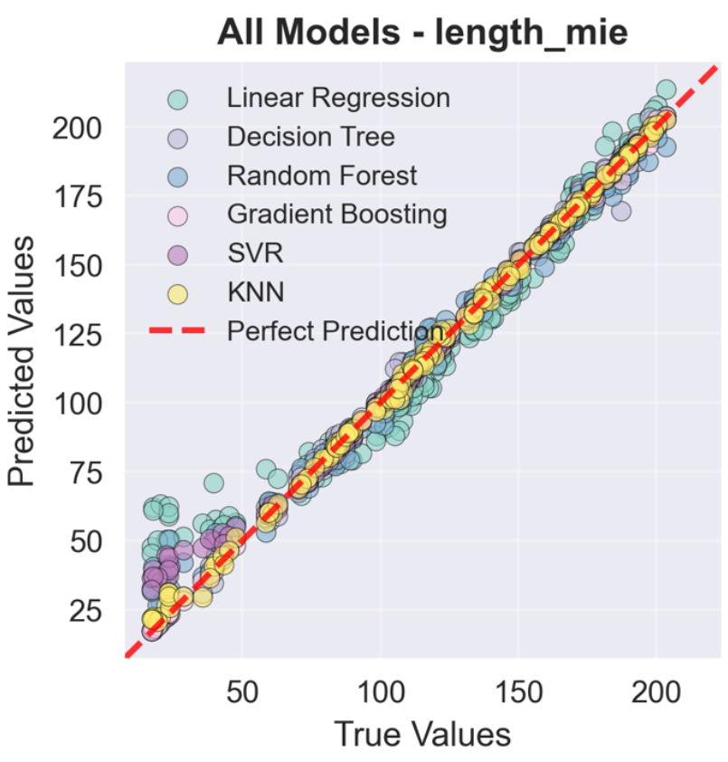
True vs Predicted for all 6 baseline ML models

Slide 9
